Slide 1
ONLINE ARTISANS STORE
PIP2001 Capstone Project
Review-2
Batch Number: CIT-G36
Under the Supervision of,
Ms. Sridevi S
Dr./Mr./Ms./Prof.
Professor / Associate Professor / Assistant Professor
School of Computer Science and Engineering
Presidency University
Roll Number | Student Name
20211CIT0064 | Bharath Kumar V
20211CIT0122 | Shreesha R
20221LIN0005 | Rahul C K
Name of the Program: B-Tech Computer Science IOT
Name of the HoD: Dr. Anandaraj S P
Name of the Program Project Coordinator: Dr. Sharmasth Vali Y
Name of the School Project Coordinators: Dr. Sampath A K / Dr. Abdul Khadar A / Mr. Md Ziaur Rahman

Slide 2
CONTENTS
Abstract
Objective of project
Problem statement
Scope and motivation
Introduction
Literature survey
Existing method
Disadvantages
Proposed method
Advantages
Project flow
Software requirements
Architecture
Modules
UML diagram
References

Slide 3
ABSTRACT
Online Arstians Store is designed to empower India's rural artisans by providing an online marketplace where they can showcase and sell their unique creations, including "Varanasi Specials." Artisans can register, upload product details, and access tools to track their performance through insights like sales, rankings, and earnings. To ensure trust, initial sales are limited to Cash on Delivery (COD) before unlocking online payment options post-verification. The platform fosters community collaboration through event management features, allowing artisans to organize or join local events. Customers can explore products ranked by popularity, while artisans gain motivation through recognitions like "Artisan of the Month" based on sales and ratings. Additionally, the platform highlights government events and exhibitions to expand their visibility and business opportunities, bridging the gap between rural craftsmanship and global markets

Slide 4
OBJECTIVE OF PROJECT
Provide artisans with a platform to market and sell their handmade products.
Create an online store with easy navigation for customers to browse and purchase products.
Incorporate features like secure payment gateways, real-time tracking, and inventory management.
Foster the growth of local economies by giving artisans a global reach.
Improve the ease of purchasing unique, handmade items that aren't available in mass markets.

Slide 5
PROBLEM STATEMENT
Rural artisans in India create beautiful, unique crafts, but they face many challenges, like limited access to markets, low visibility, and lack of trust from buyers. They often don’t have the tools or support to showcase their work and grow their businesses. This makes it hard for them to earn a stable income and gain recognition. As a result, their amazing skills and India’s rich cultural heritage risk being overlooked. There is a need for a platform that connects these artisans with customers, builds trust, encourages collaboration, and helps them grow sustainably.

Slide 6
SCOPE AND MOTIVATION
SCOPE
Development of a web-based platform for online sales.
Includes features such as user registration, product listings, secure payment systems, and order tracking.
Target audience: artisans and customers worldwide
MOTIVATION
Support the growth of handmade product markets.
Provide artisans a global platform to sell and increase income opportunities.
Enhance customer access to unique and culturally diverse products.

Slide 7
INTRODUCTION
Textiles and handicrafts are vital pillars of India's rural economy, with artisans creating masterpieces that reflect the country's rich cultural heritage. Despite their immense talent, many of these artisans remain overshadowed, lacking the platform and opportunities to showcase their work to a global audience.
This project aims to change that by offering a dedicated online platform where artisans can register, upload their products, and track their sales, earnings, and product views. The platform also allows artisans to organize and participate in local events, fostering collaboration and mutual growth.
To ensure trust and authenticity, artisans will initially sell through Cash on Delivery (COD) and, once verified, gain access to multiple payment options. Customers can explore a wide range of unique products, including "Varanasi Specials," with features that promote popular items and government exhibitions to further expand artisans' reach.
Additionally, the "Artisan of the Month" recognition will motivate artisans by acknowledging their achievements. This platform aims to empower artisans, boost their visibility, and help preserve traditional Indian crafts by connecting them to a global market

Slide 8
LITERATURE SURVEY
Current Online Marketplaces:
Platforms like Etsy, Amazon Handmade, and eBay allow artisans to sell their goods.
However, many of these platforms charge high fees and don’t focus exclusively on artisans or handmade goods.
Existing Platforms:
Lack of comprehensive features tailored for artisans (inventory management, real-time updates).
Some platforms lack personalization and customer support.
Opportunities:
A dedicated platform focused on artisans' needs, offering lower fees and better management tools.

Slide 9
EXISTING METHOD
Existing systems for textiles and handicrafts include platforms like Jaypore, Fabindia, and Craftsvilla, which provide global exposure for artisans.
Government initiatives such as the India Handmade Portal and Handloom Mark promote product authenticity and quality. Community-driven platforms like GoCoop and Okhai help connect rural artisans with buyers.
However, these systems face challenges such as high commission fees, limited digital literacy, competition from mass-produced goods, and fragmented market efforts, which hinder the full potential of artisans and their reach

Slide 10
DISADVANATGES
High commission fees on e-commerce platforms reduce artisans' profits.
Limited digital literacy among artisans makes it difficult for them to effectively use online platforms.
Competition from mass-produced goods affects the visibility and sales of handcrafted products.
Lack of financial support and limited access to modern tools and technologies hinder artisans' growth.
Inadequate promotion of individual artisans results in low visibility for their work.
Fragmented market efforts lead to a lack of cohesive strategy for promoting artisan products.
Absence of event organization features limits opportunities for artisans to collaborate and engage with customers.
Lack of personalized recognition for artisans reduces motivation and visibility.

Slide 11
PROPOSED METHOD
The proposed methodology involves developing a user-friendly platform where artisans can easily register, upload their products, and access sales statistics. The platform will allow artisans to create and participate in local events, fostering collaboration and community support.
To ensure authenticity, a verification process will be implemented, initially restricting artisans to sell five products via Cash on Delivery (COD), after which multiple payment options will be available.
The platform will highlight top-performing artisans through features like "Artisan of the Month" and offer rewards to motivate continuous engagement.
Additionally, resources like tutorials and customer feedback will support artisans in improving their products and sales strategies, promoting growth and recognition on a global scale.

Slide 12
ADVANATAGES
Increased Visibility: Provides a user-friendly platform for artisans to showcase their products, connecting them with a global audience.
Collaboration & Community Support: Enables artisans to create and participate in local events, fostering mutual collaboration and strengthening community ties.
Enhanced Trust & Credibility: The verification process ensures authenticity, boosting customer confidence in the products.
Streamlined Transactions: Offering multiple payment options post-verification simplifies the sales process and encourages transactions.
Motivation & Recognition: Recognizes and rewards top-performing artisans, motivating continued engagement and fostering a sense of achievement.
Sustainable Growth: Supports the long-term development of artisans and helps expand their market reach globally.

Slide 13
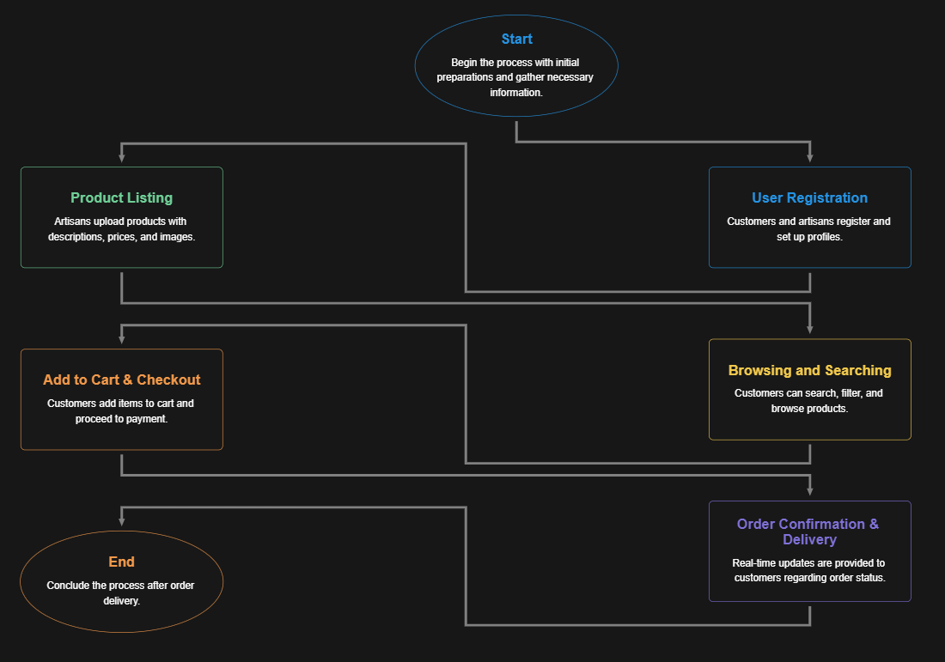
PROJECT FLOW

Slide 14
SOFTWARE REQUIREMENTS
Frontend:
HTML5, CSS3, JavaScript (React or Angular for dynamic interfaces).
Backend:
Node.js with Express (for handling requests).
MongoDB for database management.
Payment Gateway:
PayPal, Stripe, or other secure payment systems.
Version Control:
Git and GitHub for version management.

Slide 15
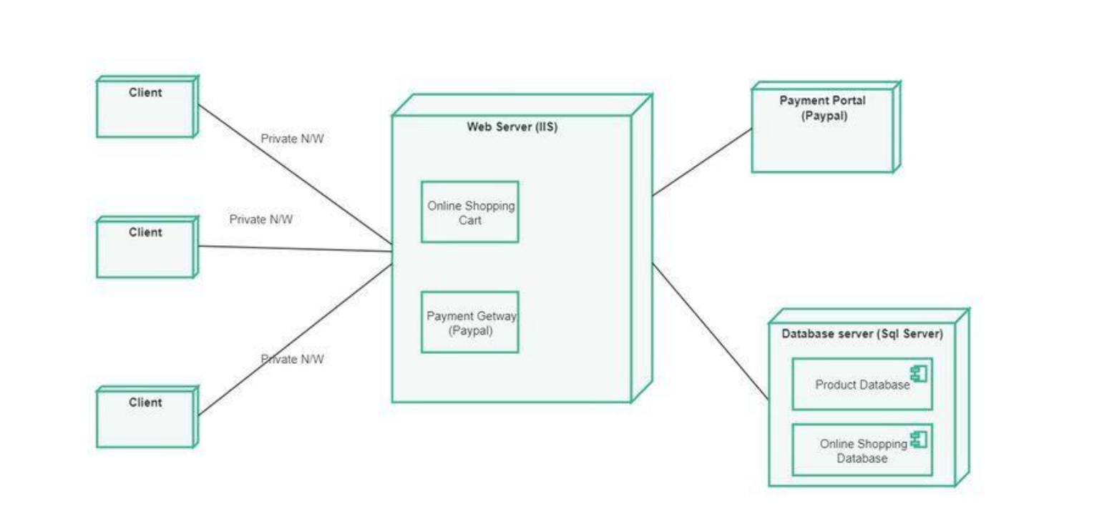
ARCHITECTURE

Slide 16
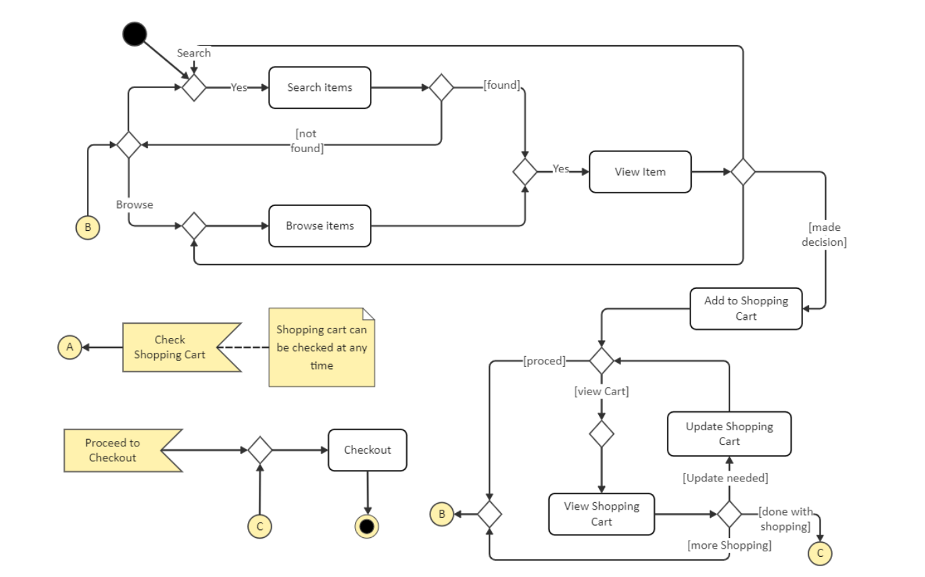
ARCHITECTURE

Slide 17
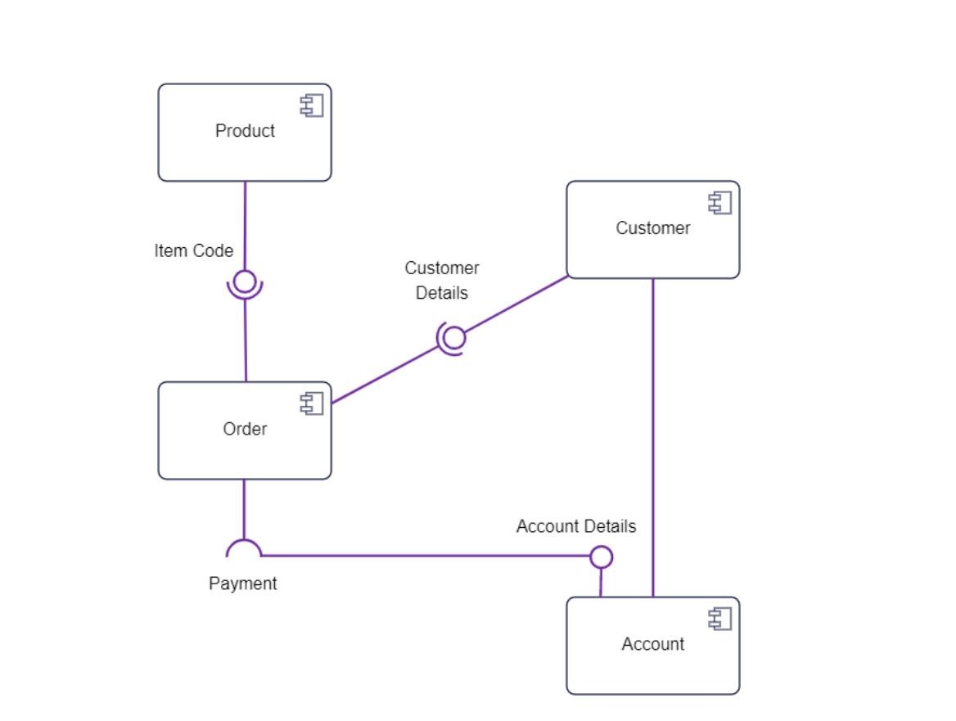
ARCHITECTURE

Slide 18
MODULES
User Management: Handles registration, login, and profile management.
Product Management: Allows artisans to add, edit, and delete product listings.
Order Management: Manages customer orders, tracking, and updates.
Payment Gateway: Secure processing of customer payments.
Review System: Allows customers to review and rate products.

Slide 19
REFERENCES
1. Arunava Dalal , Dr. Subrata Chattopadhyay, “A Preliminary Study on Popularizing Indian Handicrafts Using Internet Technology – A Bengal Specific Study”, April 2021.
2. Aabha Patil, Ritu Shailendra Jha, Ritu Raju Jha, Nandini Vijay Gurav, “EPICRAFT –WEBSITE FOR ARTISANS”, November 2022
3. Amisha Shah, Rajev Patel, “E-COMMERCE AND RURAL HANDICRAFT ARTISANS”, December 2016
4. M.Ushasri , N.Charitha , P.Chaitanya , G.Giridhar Sai , D.Venkata Kumar5, “E-Commerce Website For Handloom”, May 2022
5. Aditi Bhatia Kalluri, “E-COMMERCE FOR RURAL MICRO-ENTREPRENEURS: MAPPING RESTRICTIONS, ECOLOGIES OF USE AND TRENDS FOR DEVELOPMENT”, 2021
6. Indrajit Ghosal, Bikram Prasad, “Inspiring Digitalization of Handicraft Market: An empirical approach”, December 2019
7. Darshil Ajudia, Akshat Chandel, Hinal Kuvadiya, “Online Handicrafts Store”, 2021
8. Sunil Kumar Das Bendi, “Role of E-Commerce in Promoting Handicrafts of Odisha”, November 2018
9. Haryadi Sarjono, Ria Trianti, Heppy Yohanes,” Systematic Literature Review the Role of E-Commerce in Reog Ponorogo Art Crafters”, September 2021
10. Ruheela Hassan, Parvez Ahmed Mir, “PROBLEMS AND REVIVAL OF HANDICRAFT INDUSTRY IN KASHMIR – AN ANALYSIS”, 2020

Slide 20


